Slide 1

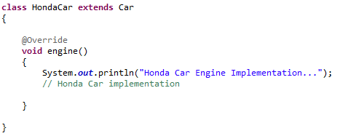
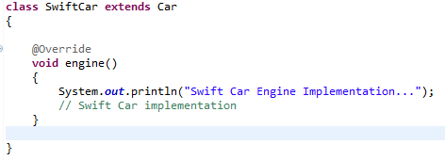
When to use Abstract Methods & Abstract Class?
Abstract methods are usually declared where two or more subclasses are expected to do a similar thing in different ways through different implementations. These subclasses extend the same Abstract class and provide different implementations for the abstract methods.
Abstract classes are used to define generic types of behaviors at the top of an object-oriented programming class hierarchy, and use its subclasses to provide implementation details of the abstract class.
extends
extends

